Slide 1
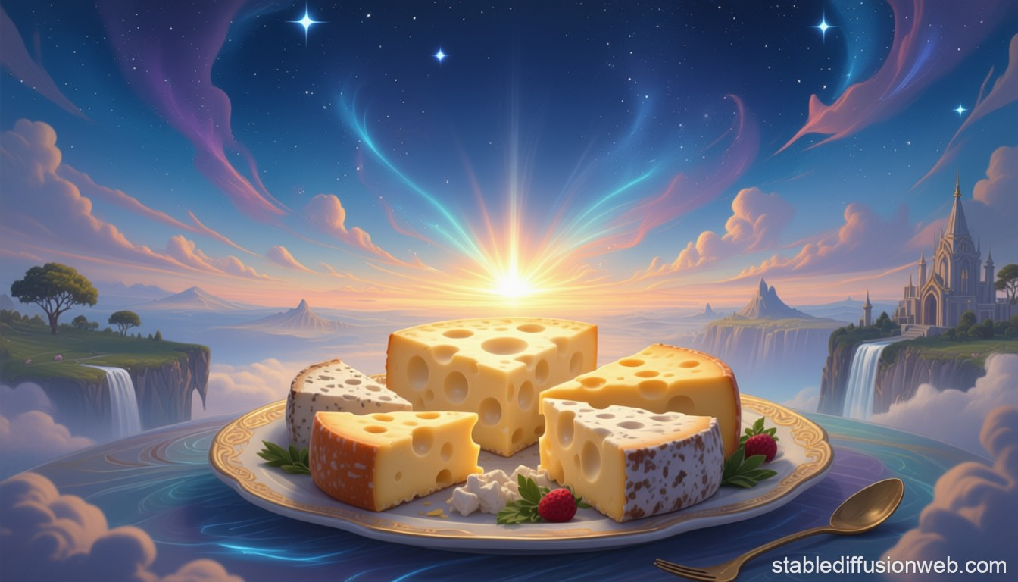

An ω-categorical cheese platter
for finite-domain
Promise Constraint Satisfaction Problems

Slide 2

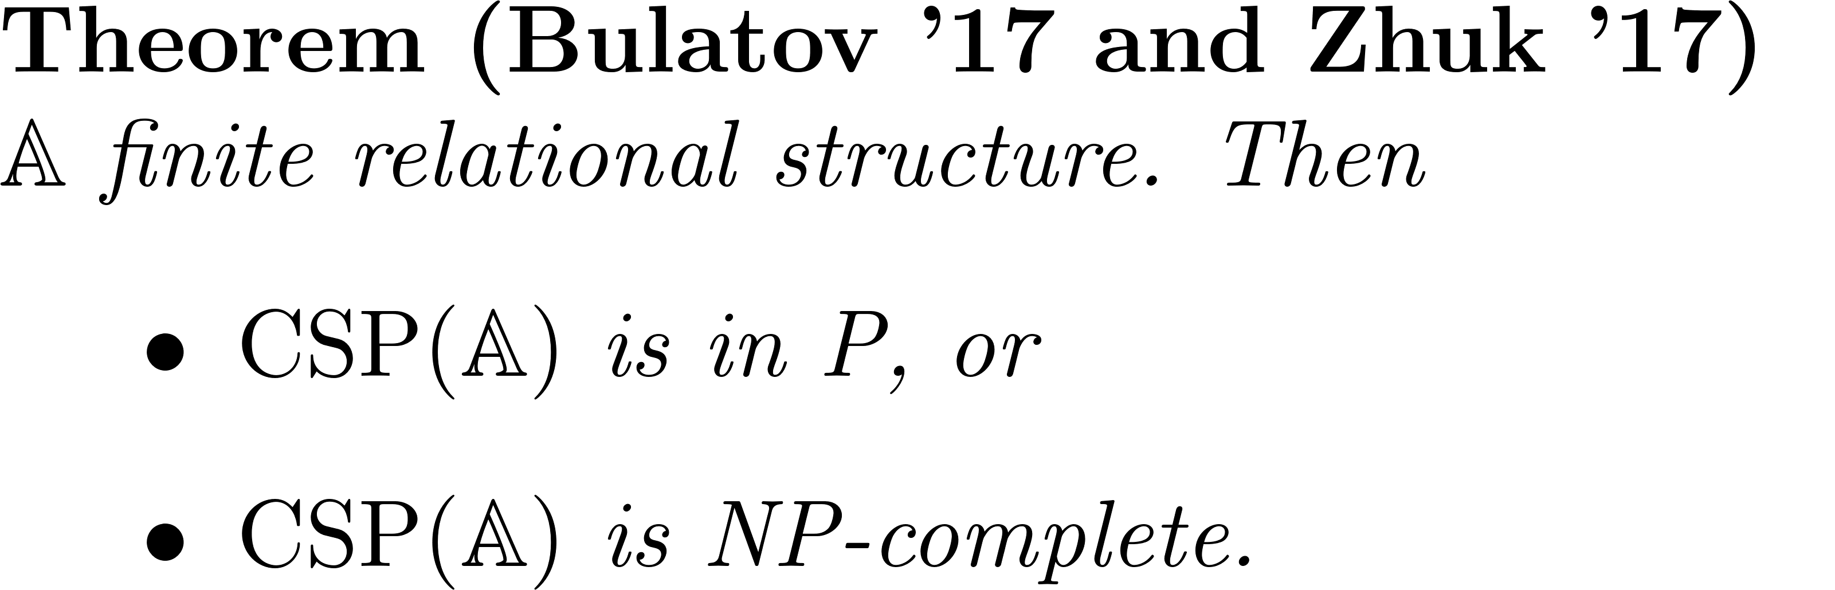
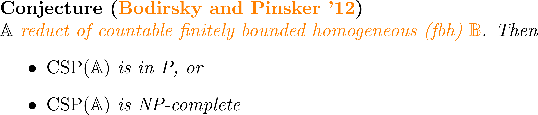
Notes:
Mention assuming P neq NP
Mention outside NP without fbh

Slide 3

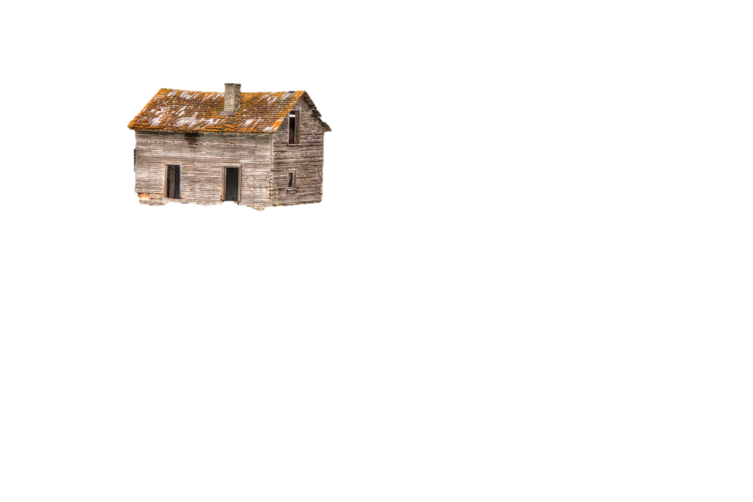





Three Fundamental Questions in Modern Infinite-Domain Constraint Satisfaction
Michael Pinsker, Jakub Rydval, Moritz Schöbi, Christoph Spiess
Inf.-dom. CSPs
Fin.-dom. PCSPs
Picture created with Google Gemini 2.5 Flash

Slide 4











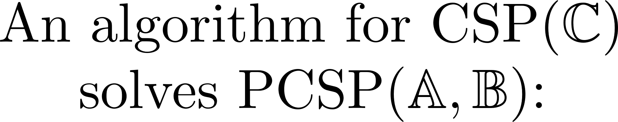
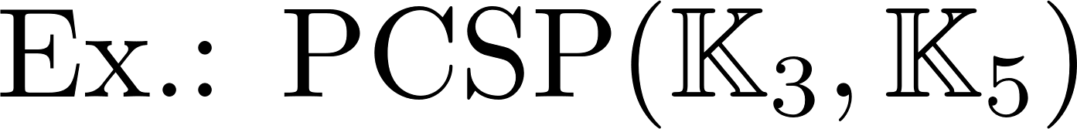




✓
x
✓
x

Slide 5


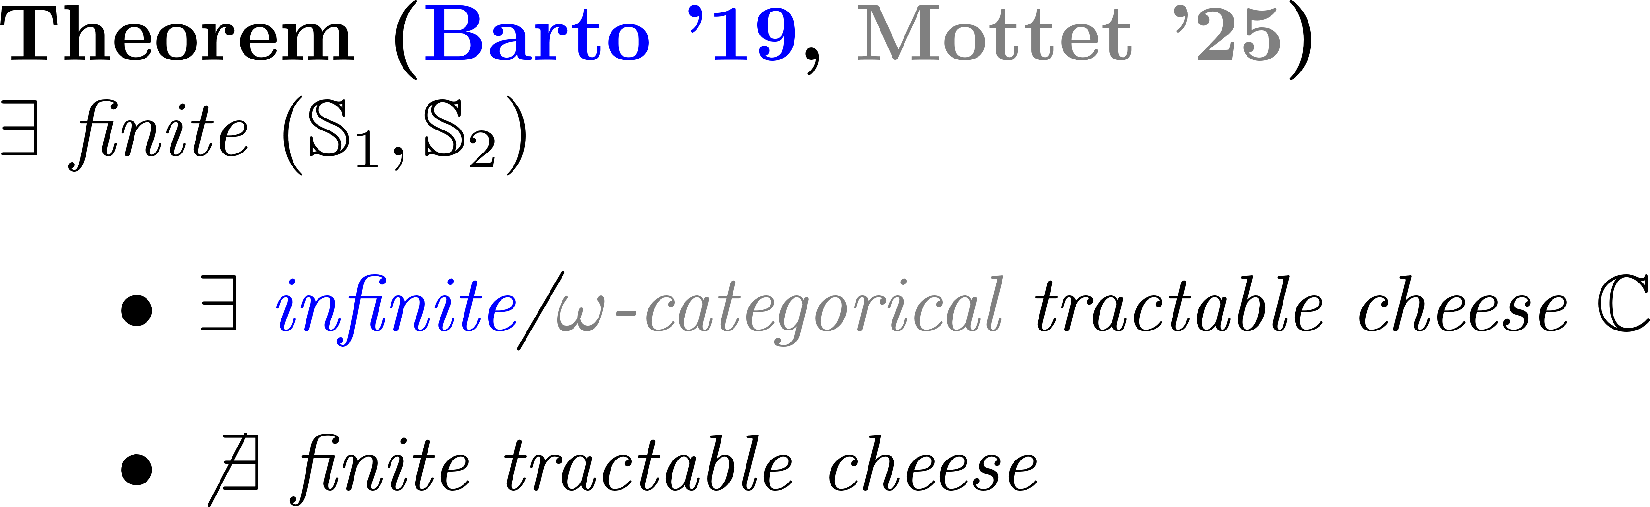
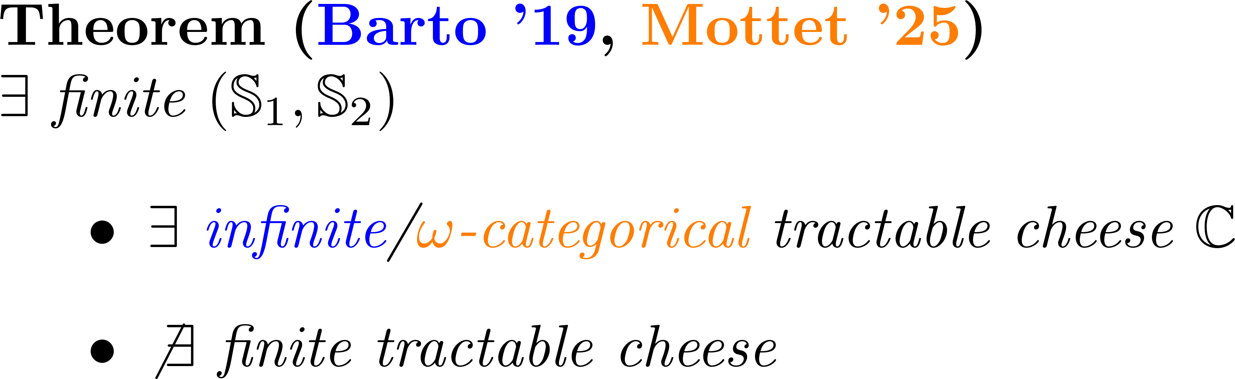








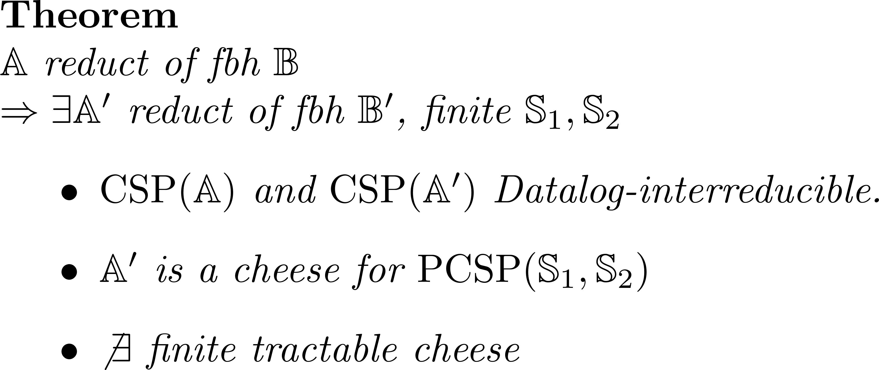








X
X

Slide 6

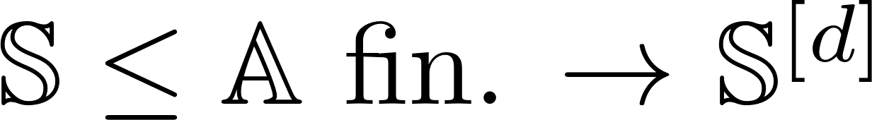

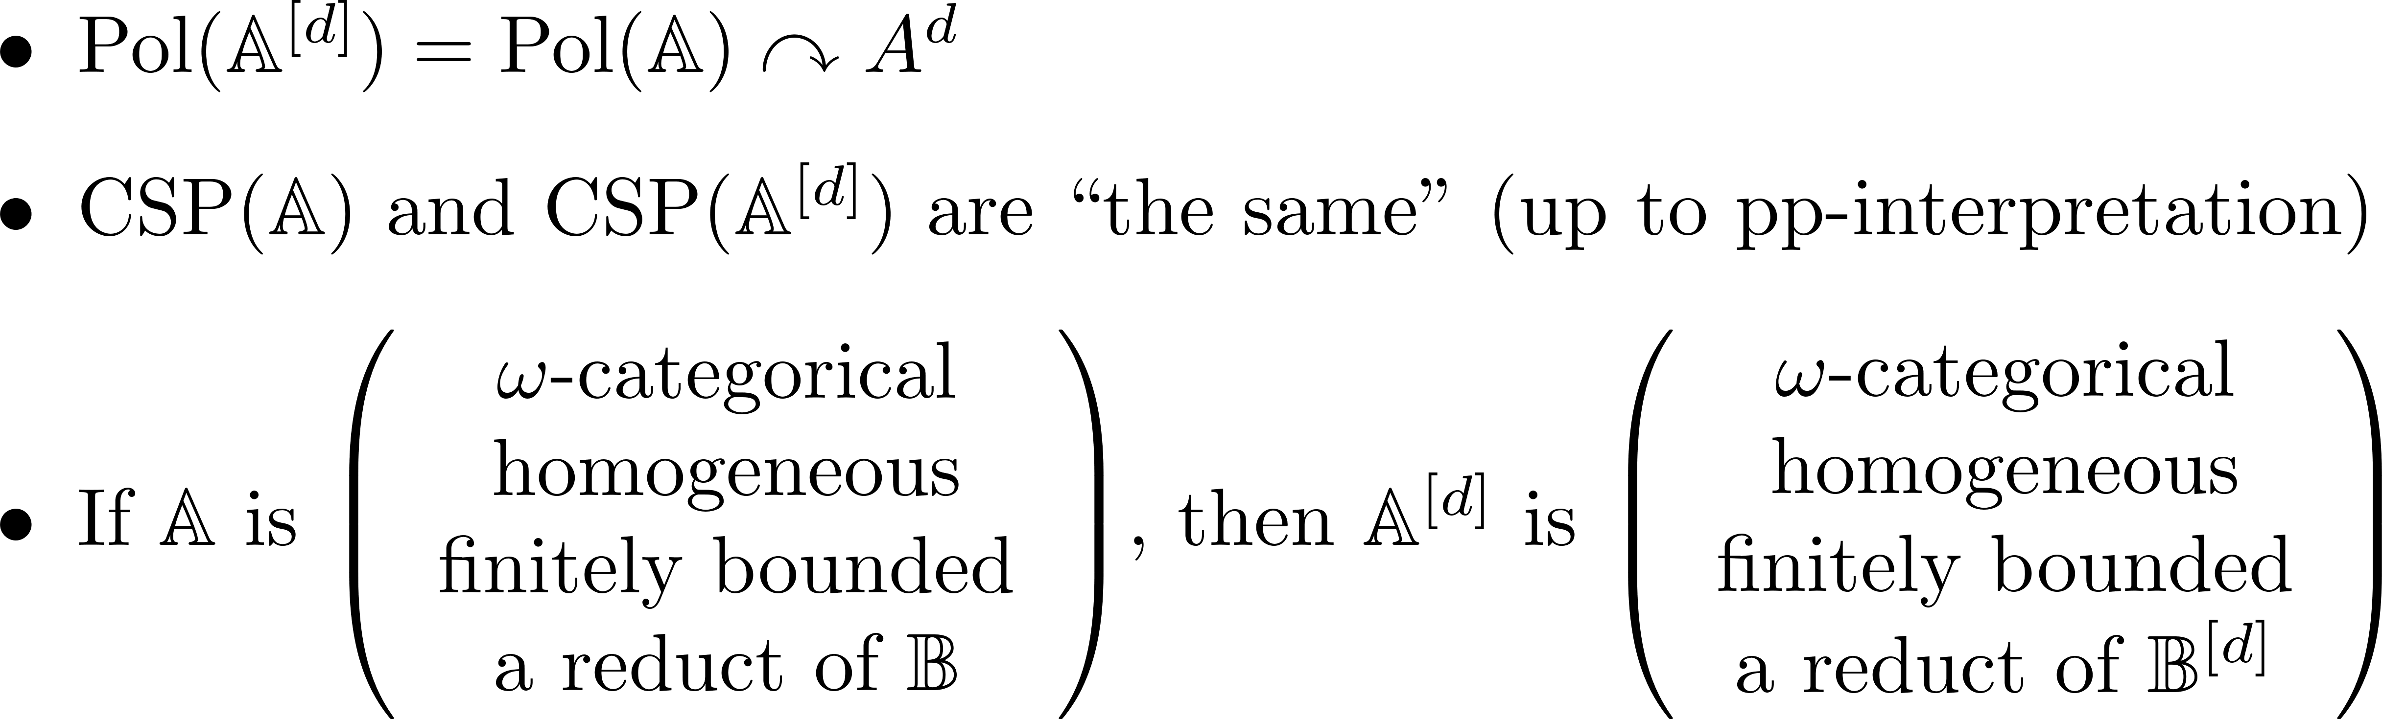
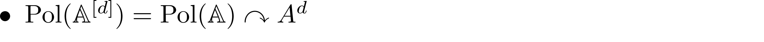

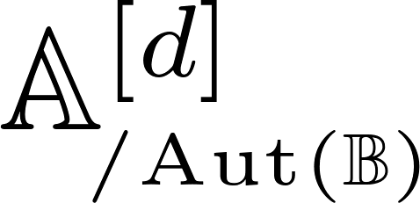


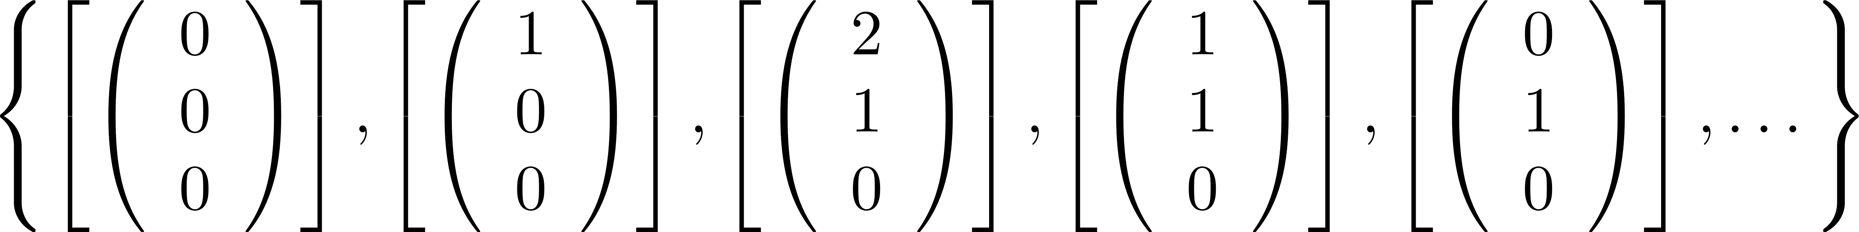
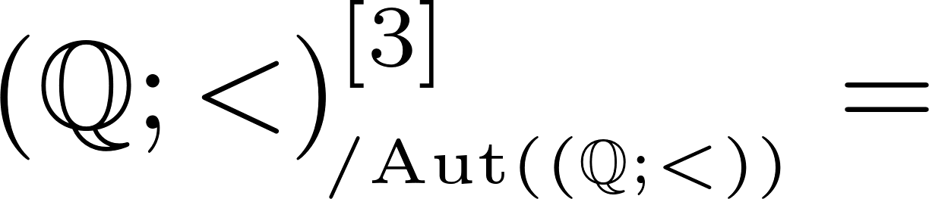
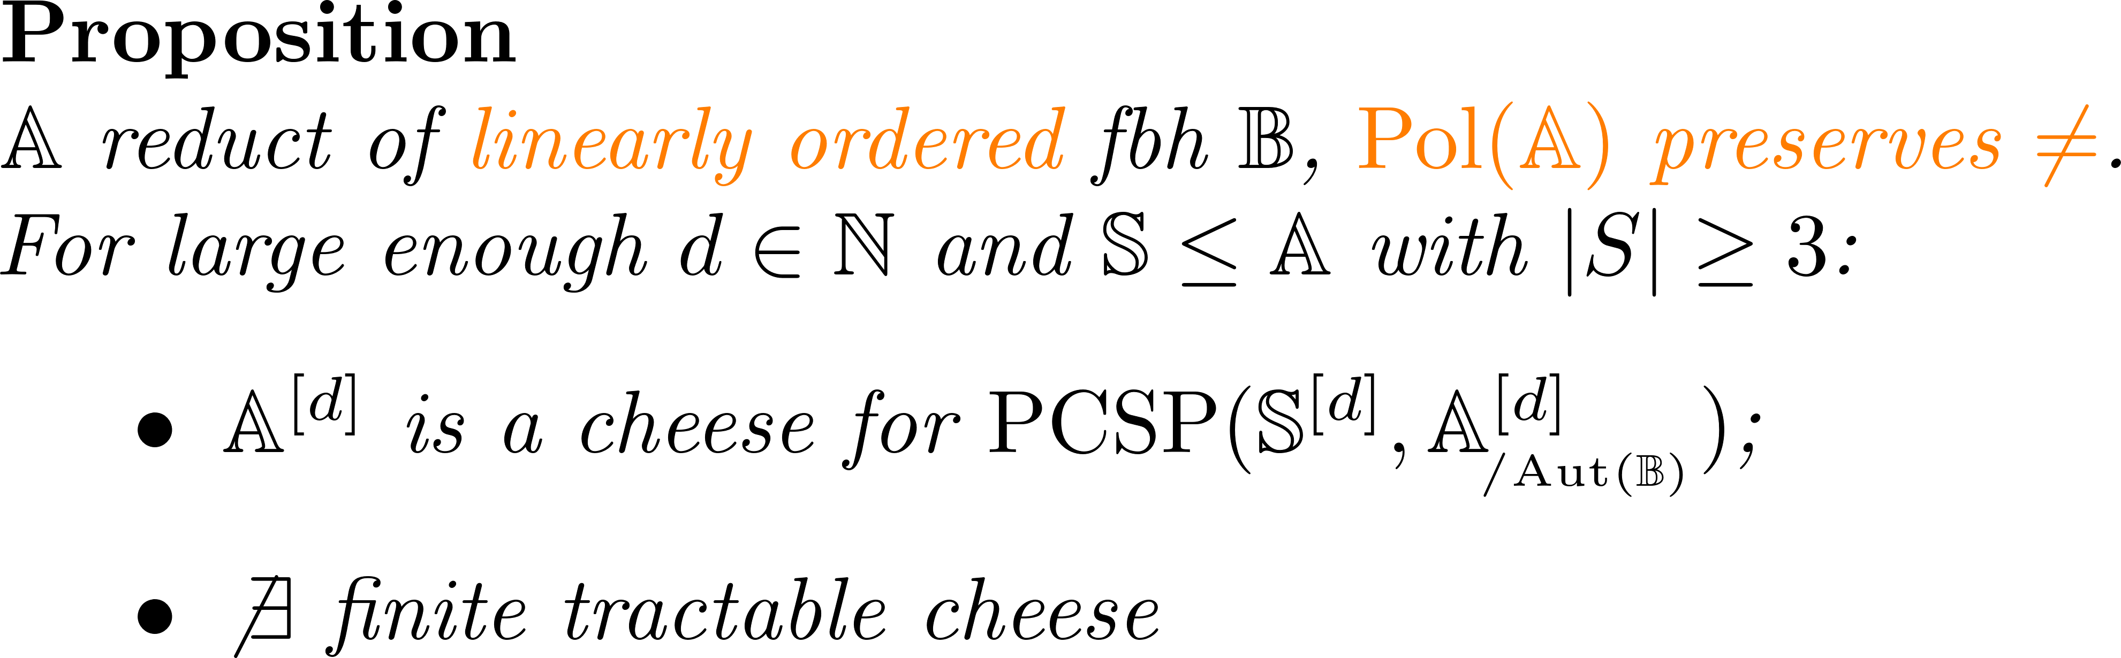



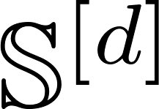
X

Slide 7





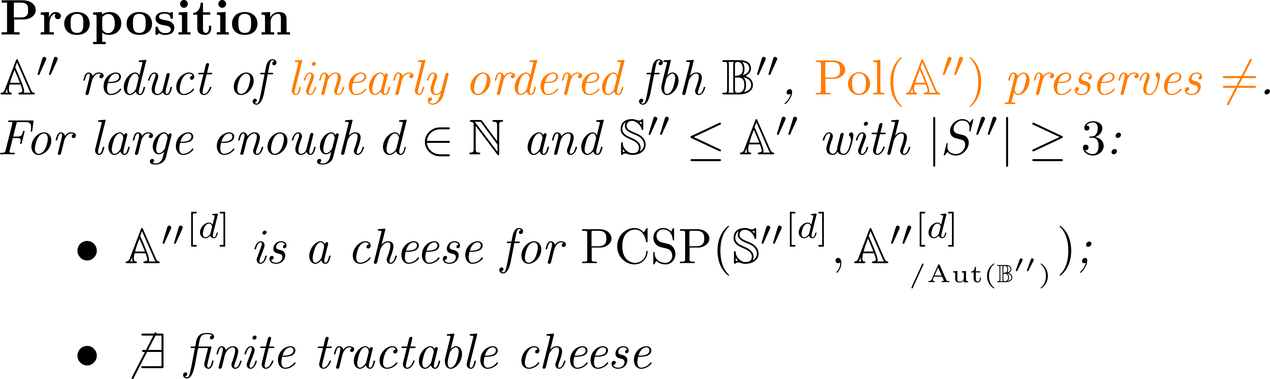
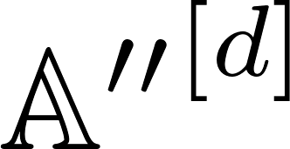
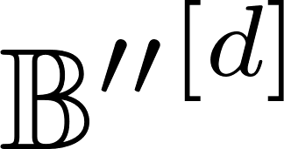
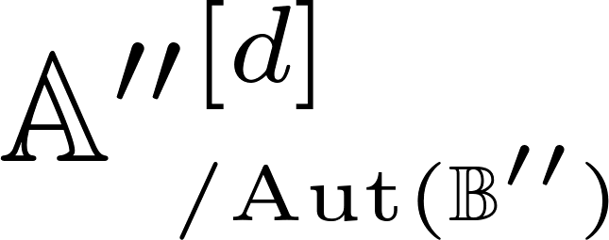
X

Slide 8

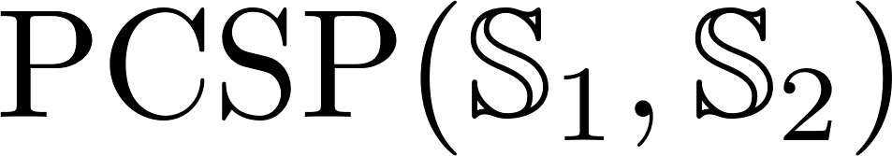




X

Slide 9
Three Fundamental Questions in Modern Infinite-Domain Constraint Satisfaction
Michael Pinsker, Jakub Rydval, Moritz Schöbi, Christoph Spiess
Inf.-dom. CSPs
Fin.-dom. PCSPs
Picture created with Google Gemini 2.5 Flash

Slide 10


Slide 11
Three Fundamental Questions in Modern Infinite-Domain Constraint Satisfaction Michael Pinsker, Jakub Rydval, Moritz Schöbi, Christoph Spiess MFCS 2025, Warsaw

Slide 12


Three Fundamental Questions in Modern Infinite-Domain Constraint Satisfaction
Michael Pinsker, Jakub Rydval, Moritz Schöbi, Christoph Spiess
Inf.-dom. CSPs
Fin.-dom. PCSPs
Picture created with Google Gemini 2.5 Flash

Slide 13
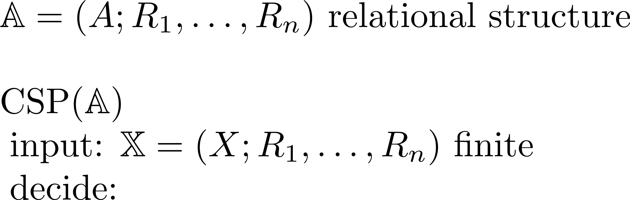
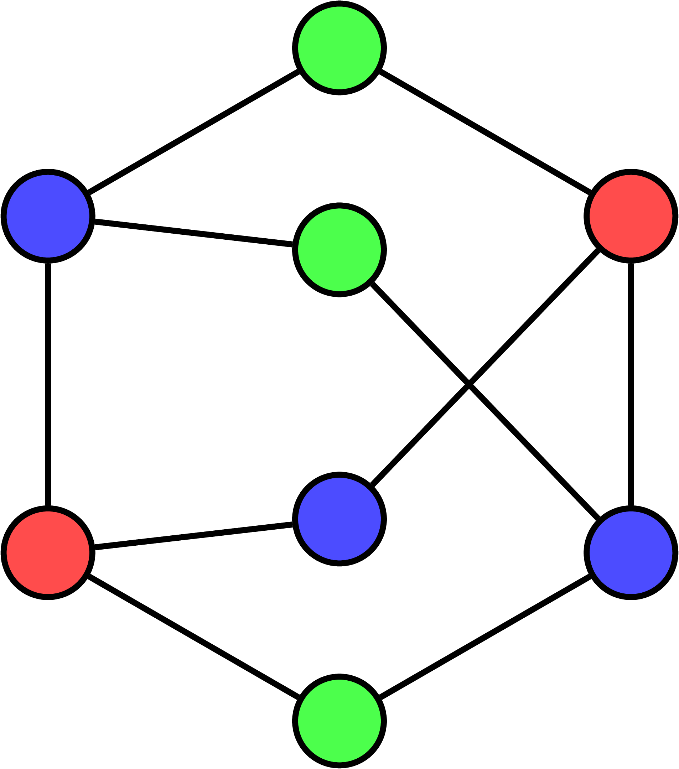
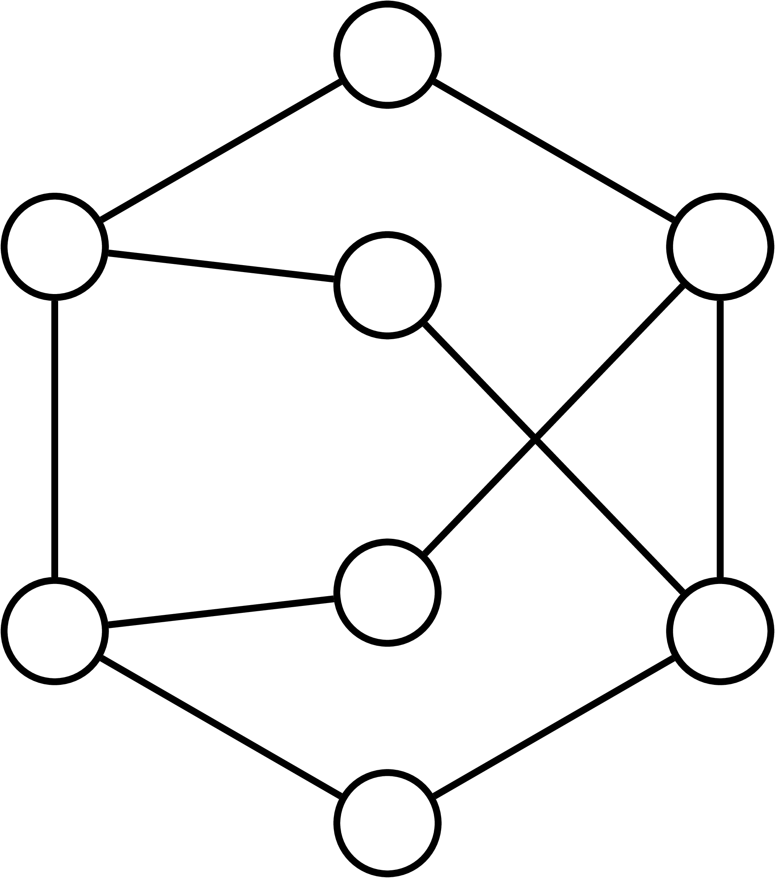

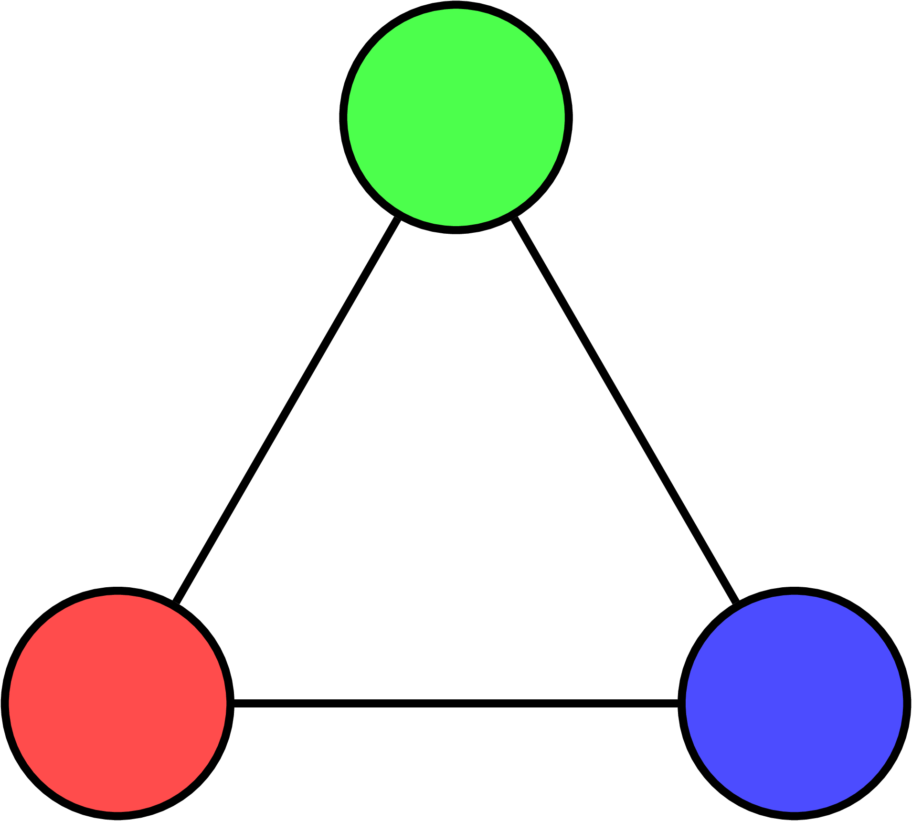
✓
x

Slide 14
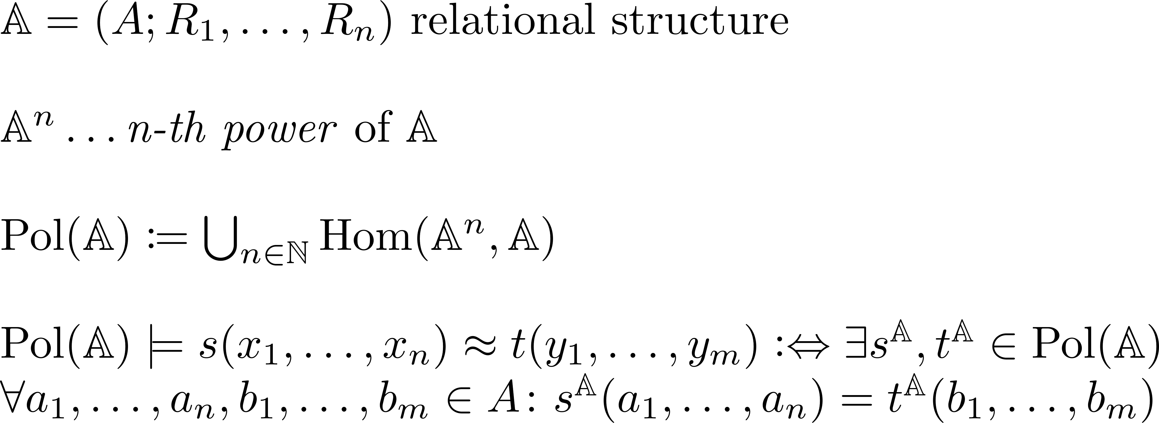

Slide 15
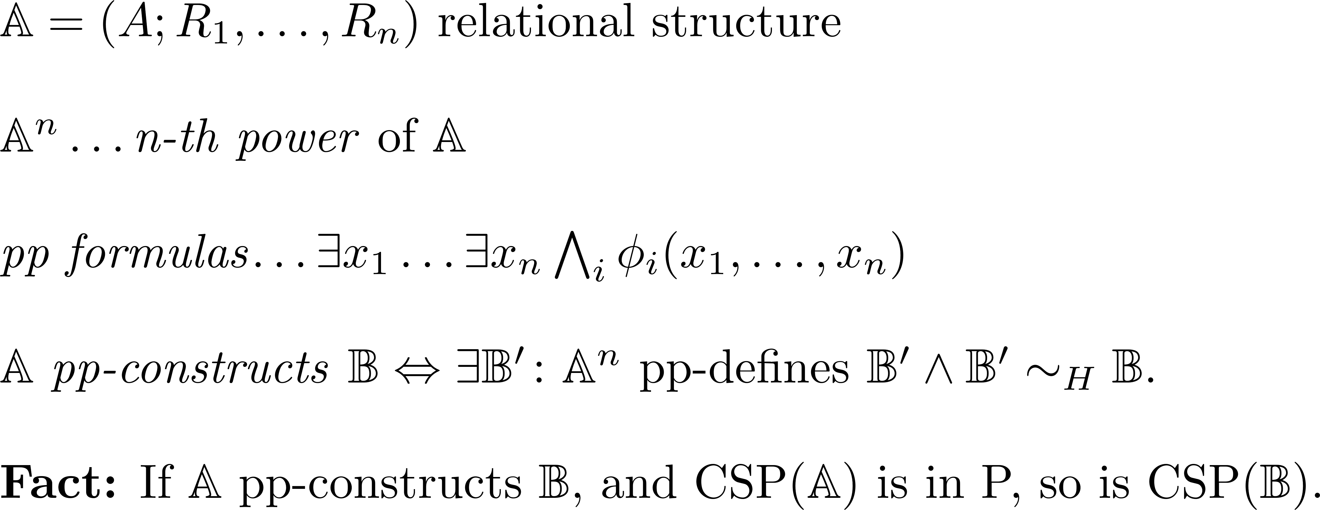

Slide 16
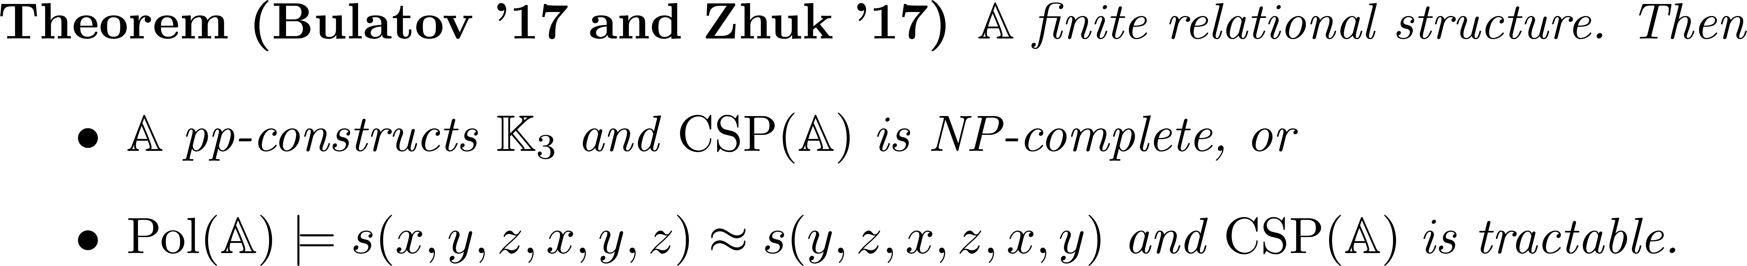
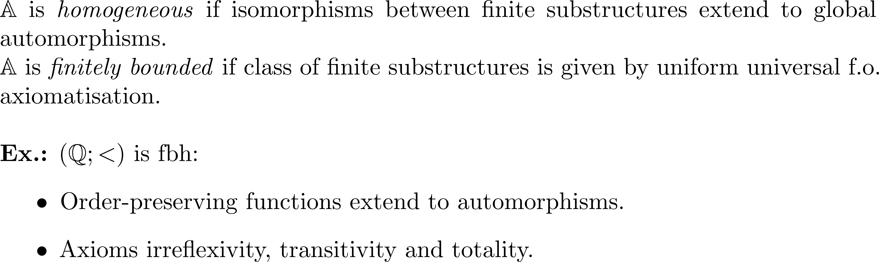
Notes:
Mention assuming P neq NP
Mention outside NP without fbh

Slide 17
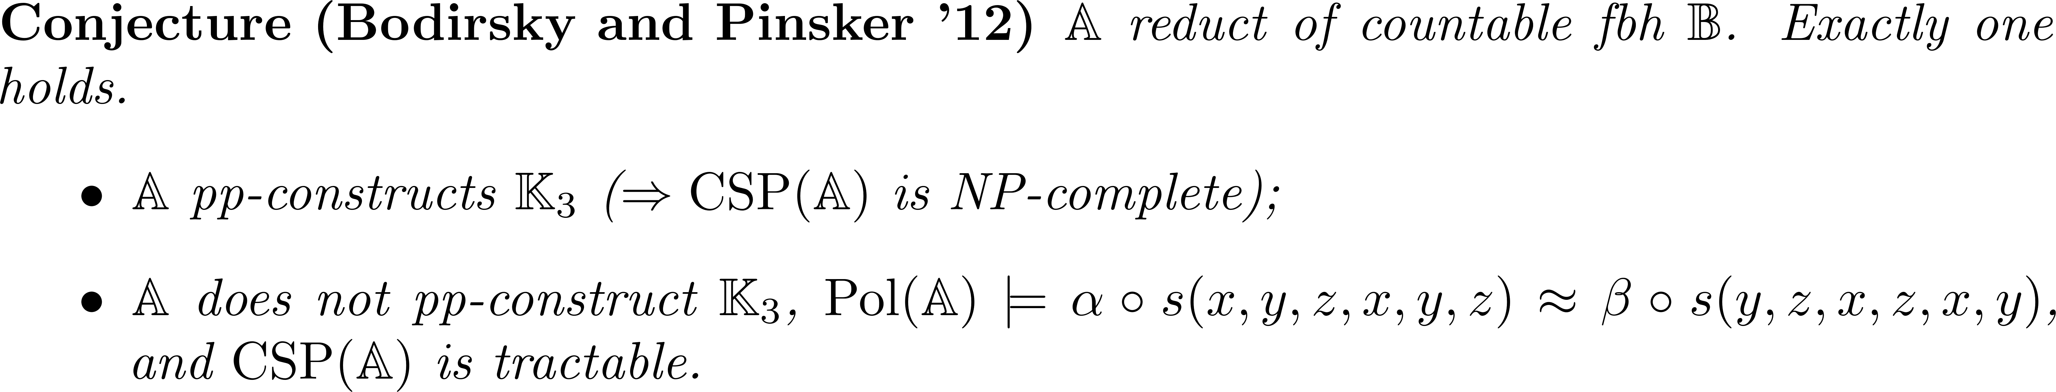
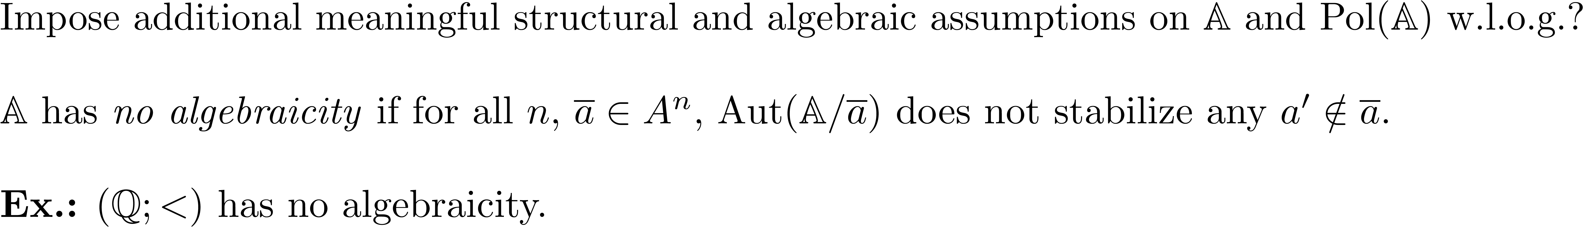
Notes:
Define reduct

Slide 18
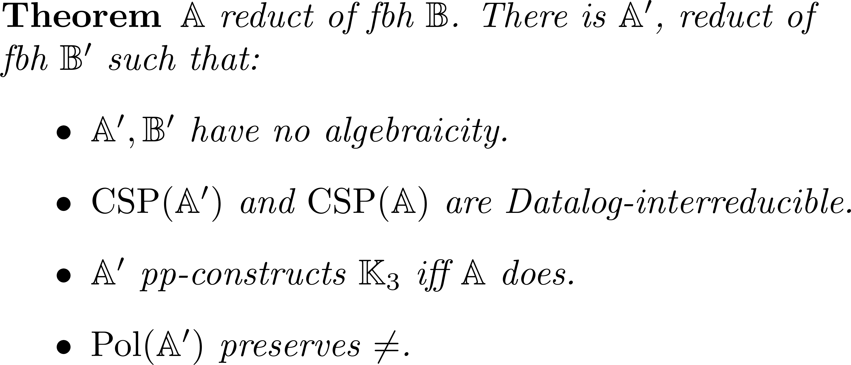



Slide 19
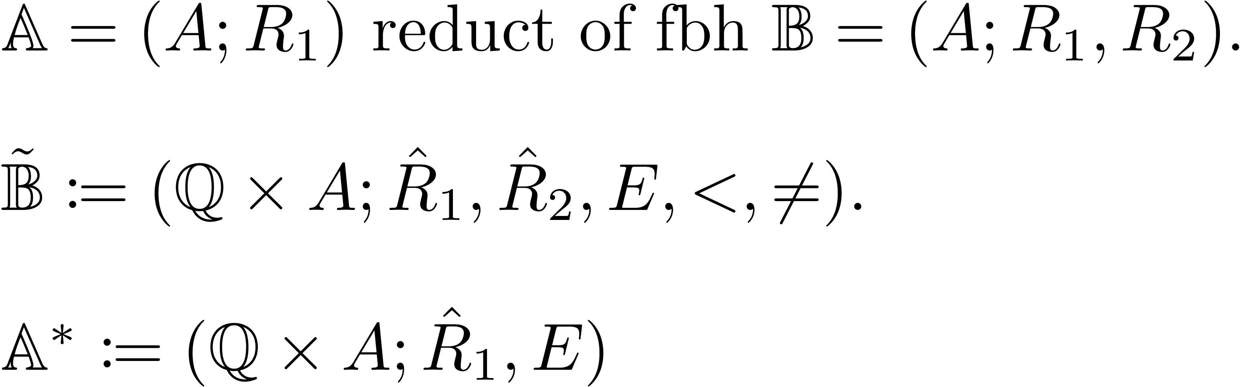
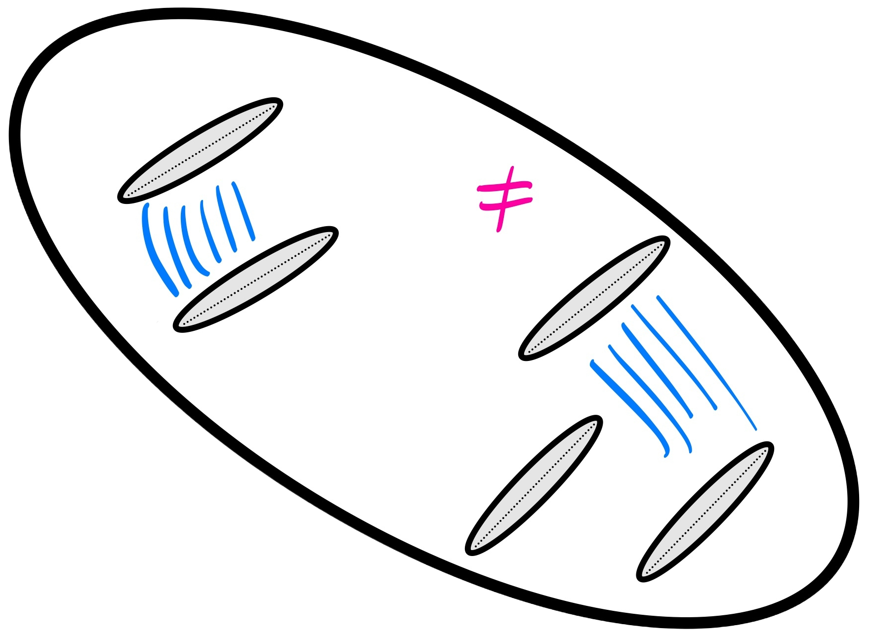



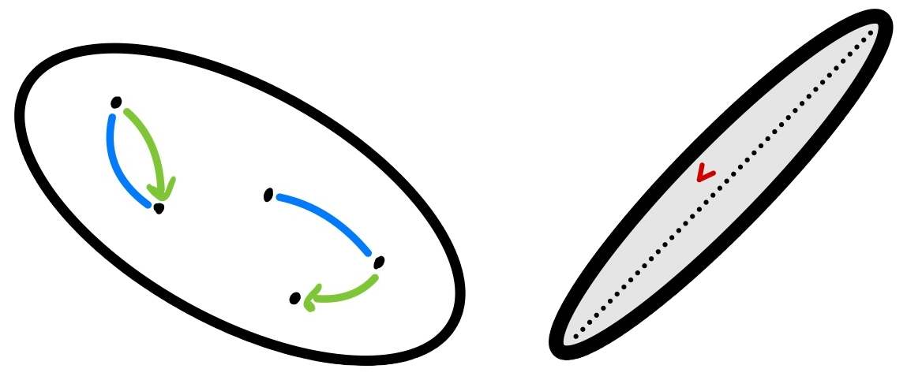


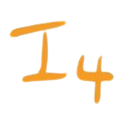
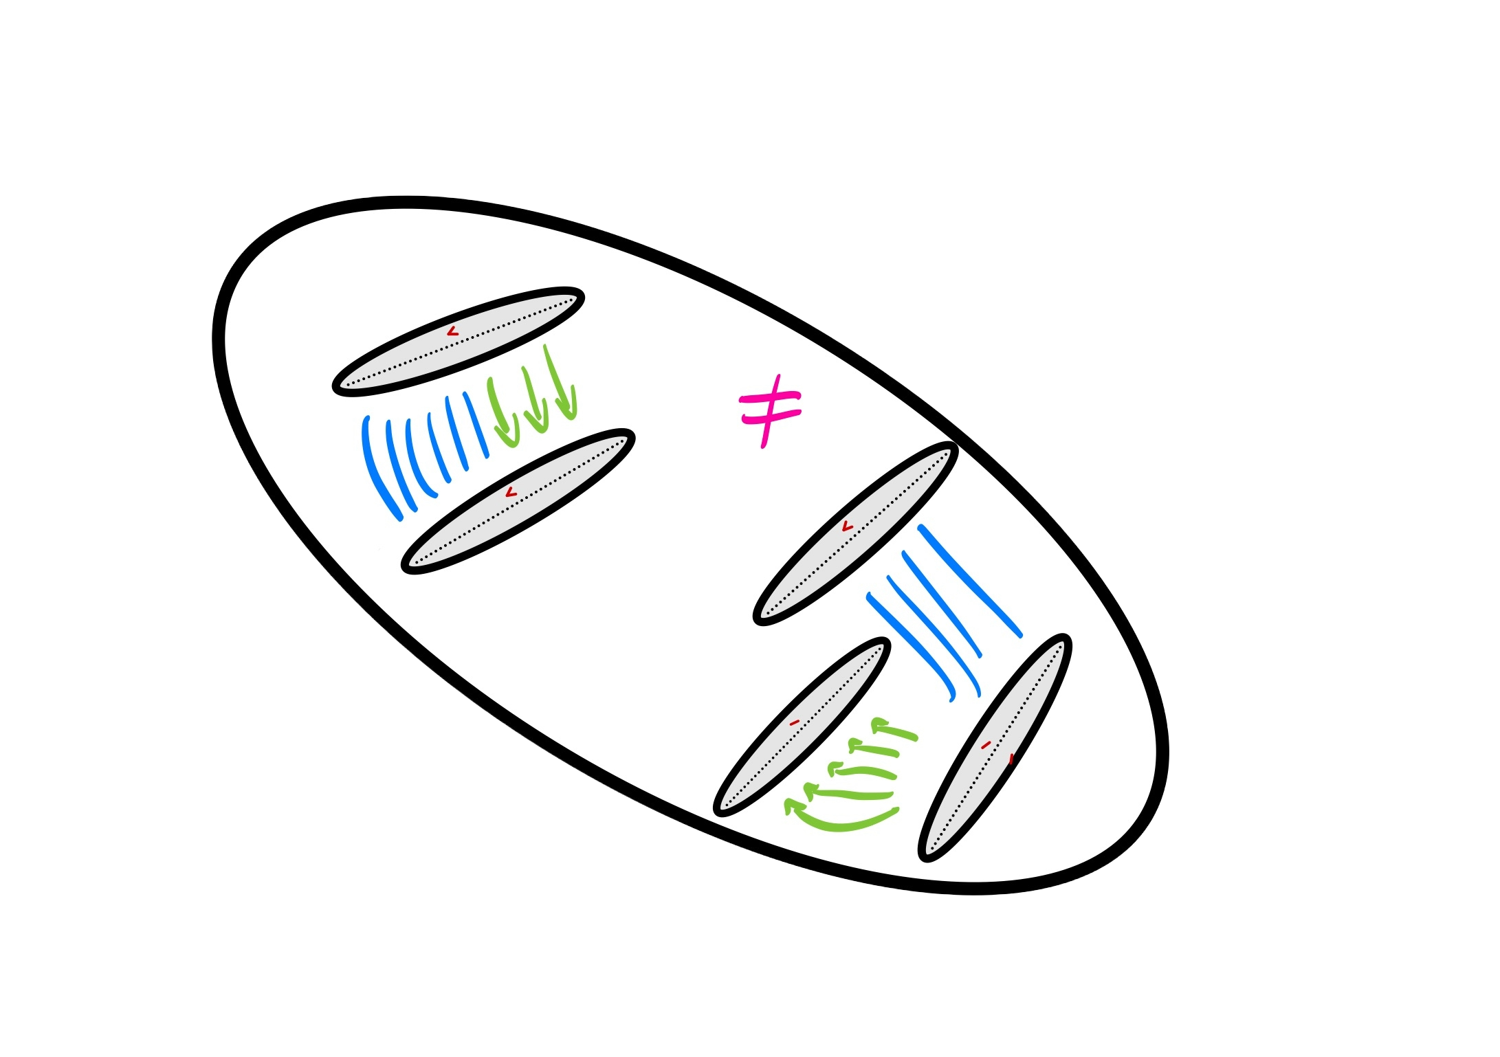


Notes:
Zusammenfassen
Datalog Satz
CSP inj nur sagen

Slide 20

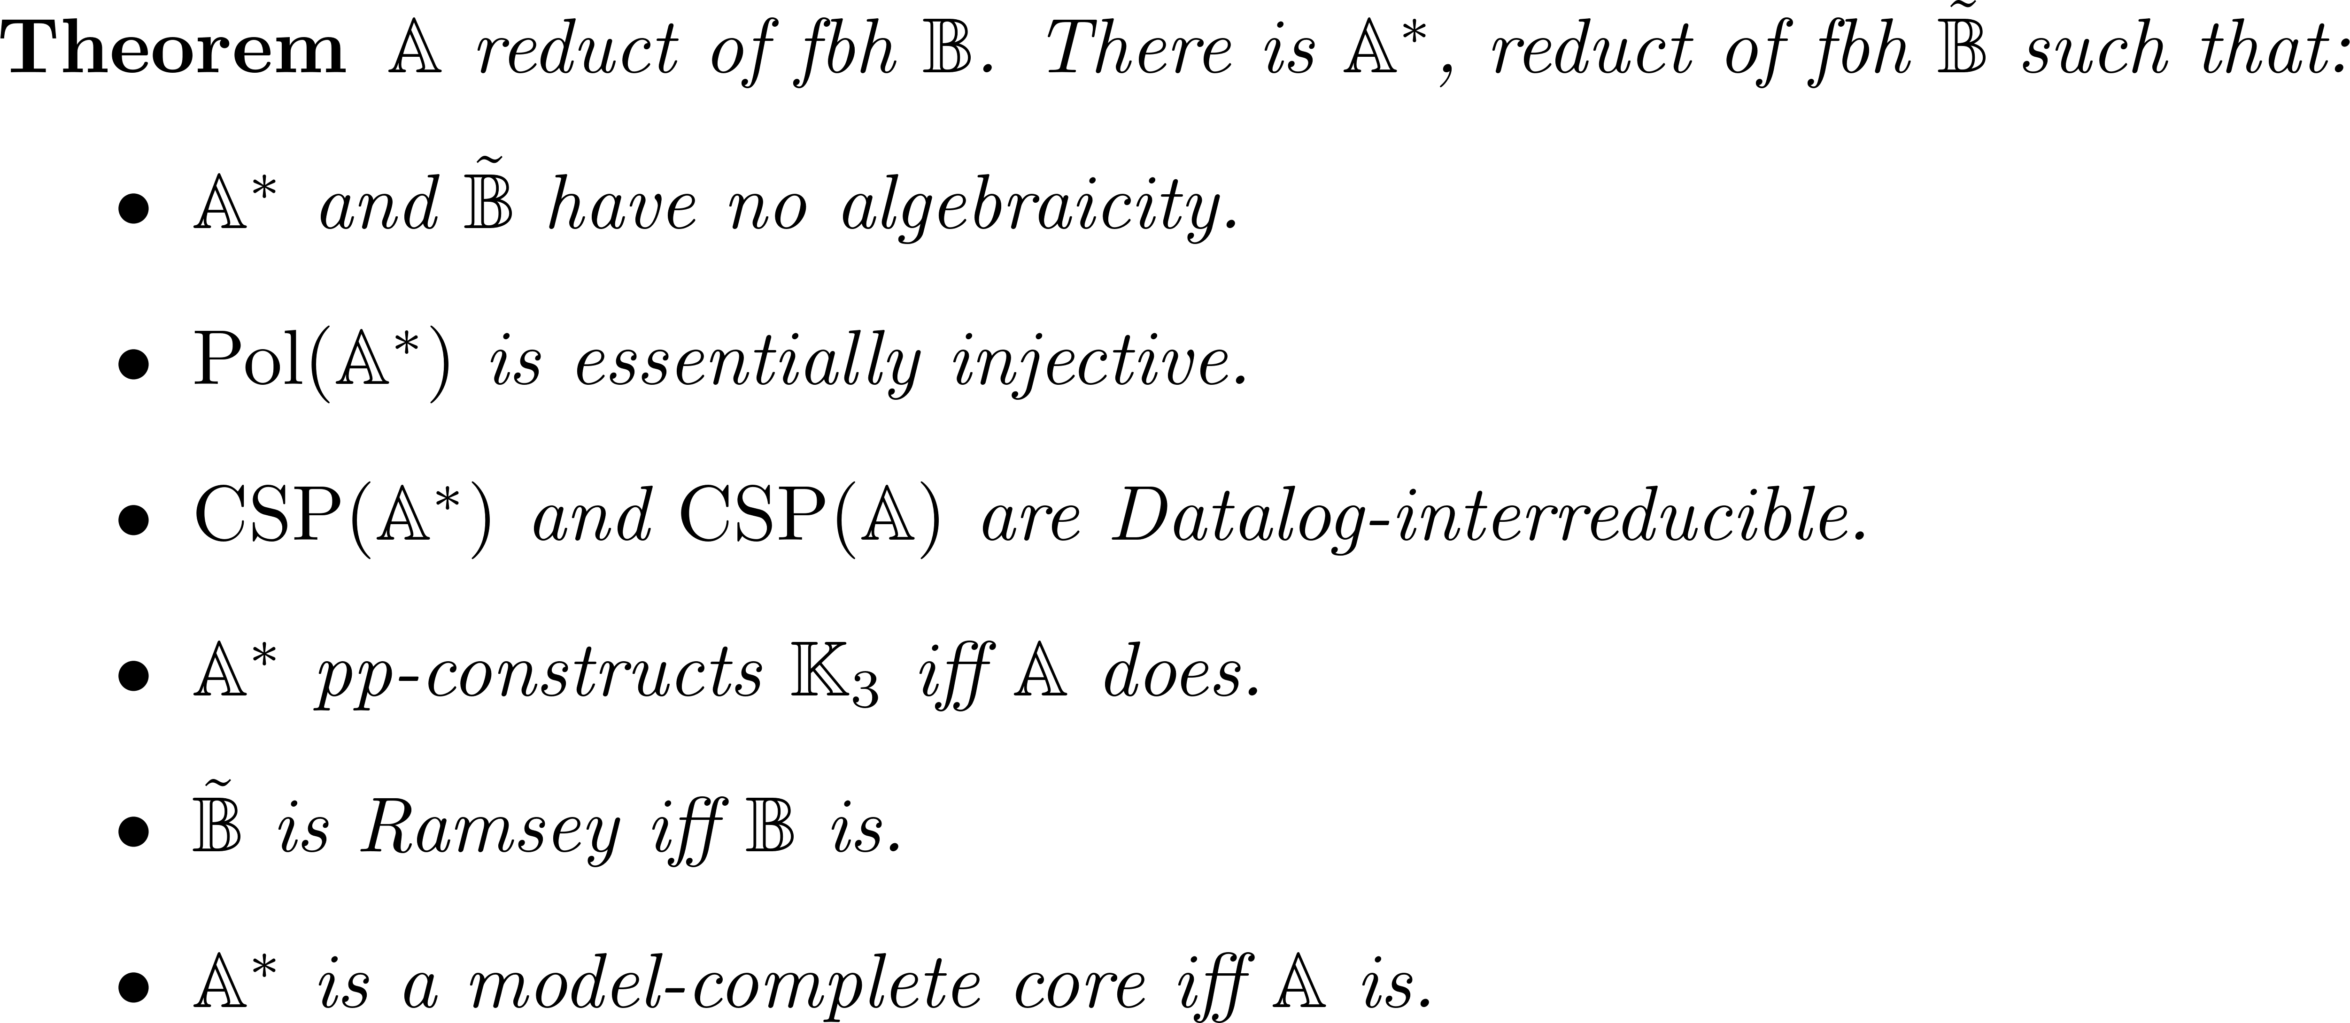
x
✓

Slide 21
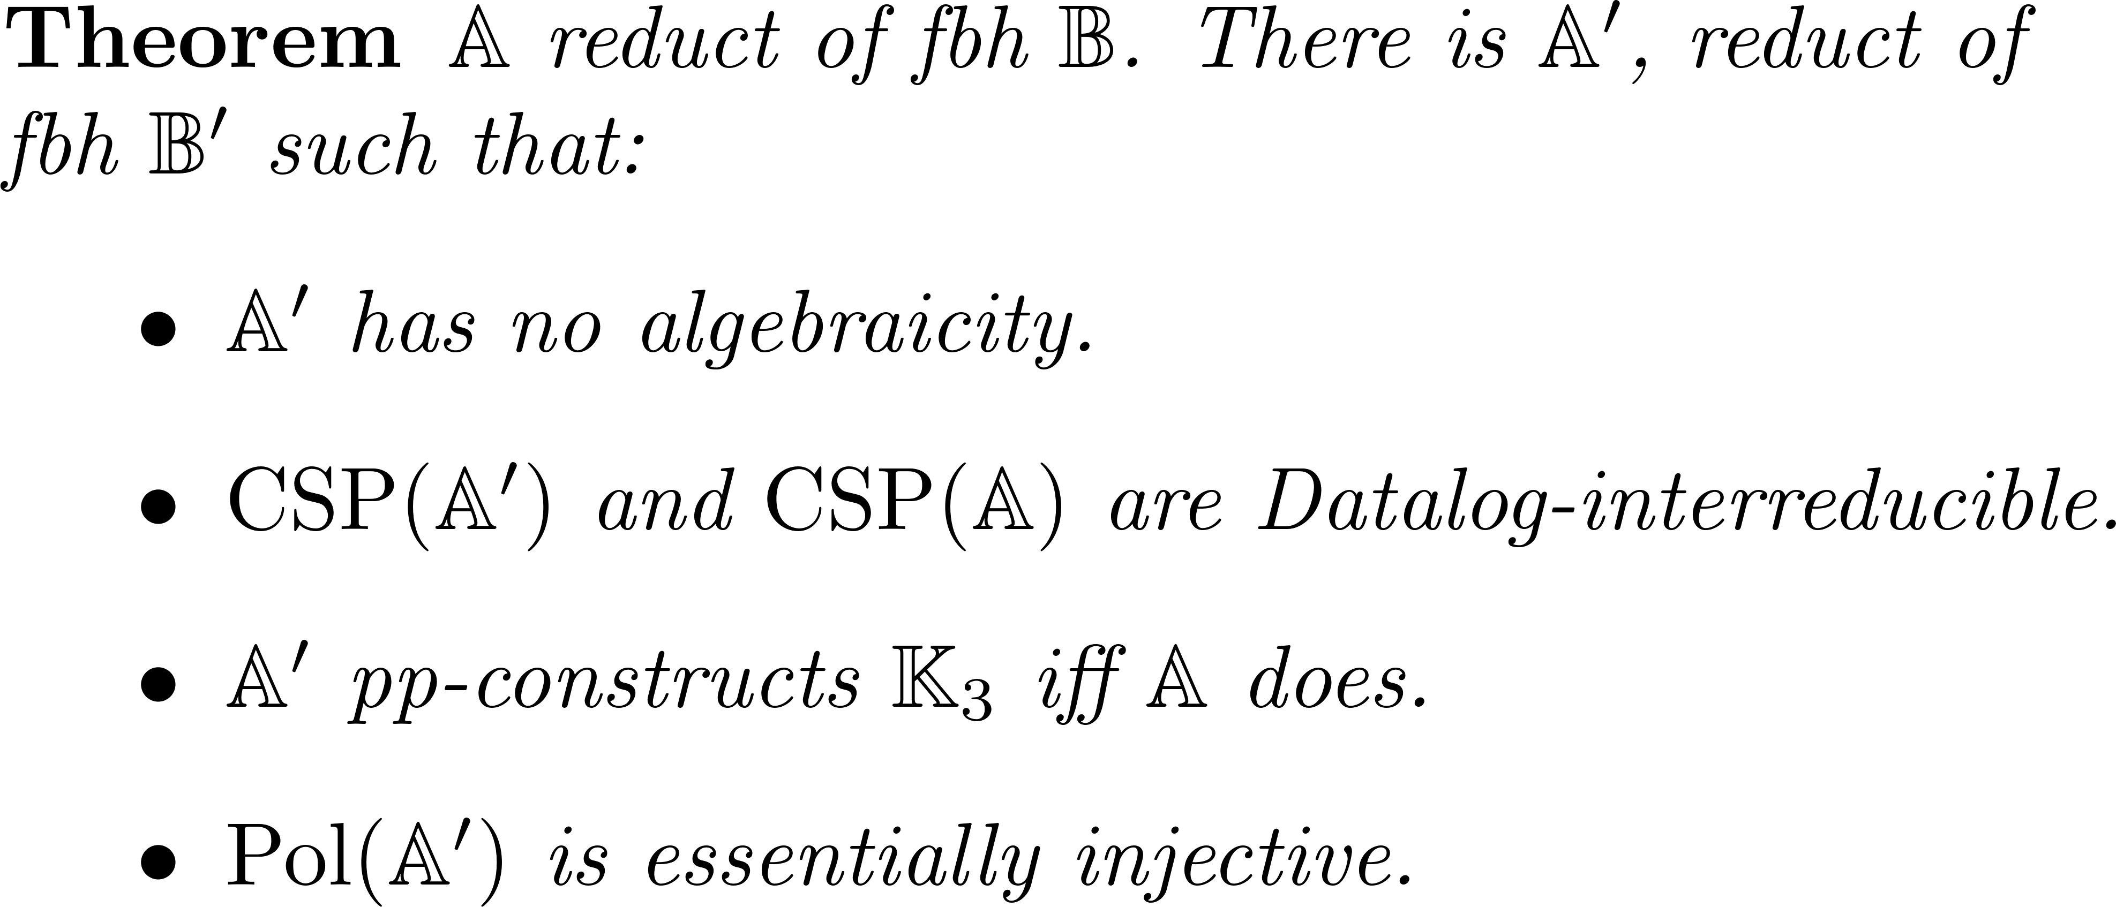
x
✓

Slide 22
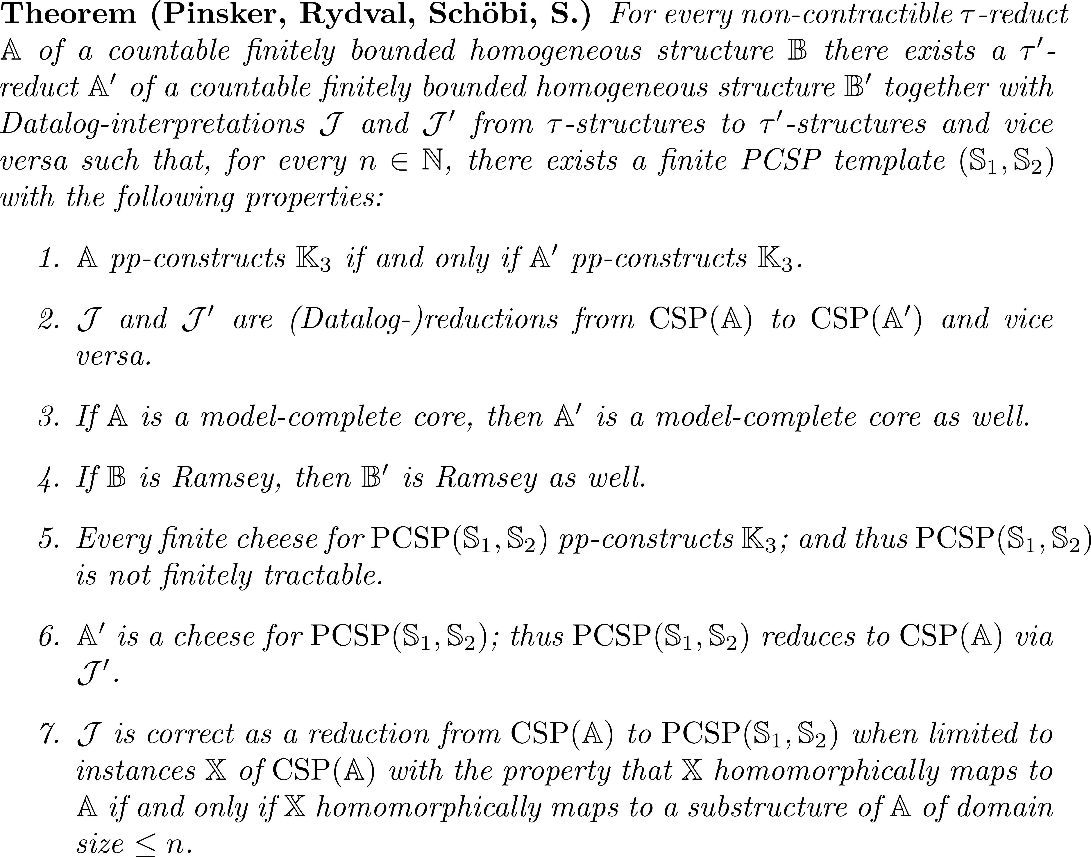

Slide 23

Inf.-dom. CSPs
Fin.-dom. PCSPs
Finite-domain CSP dichotomy theorem

Slide 24



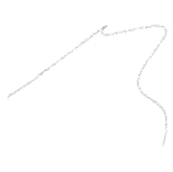




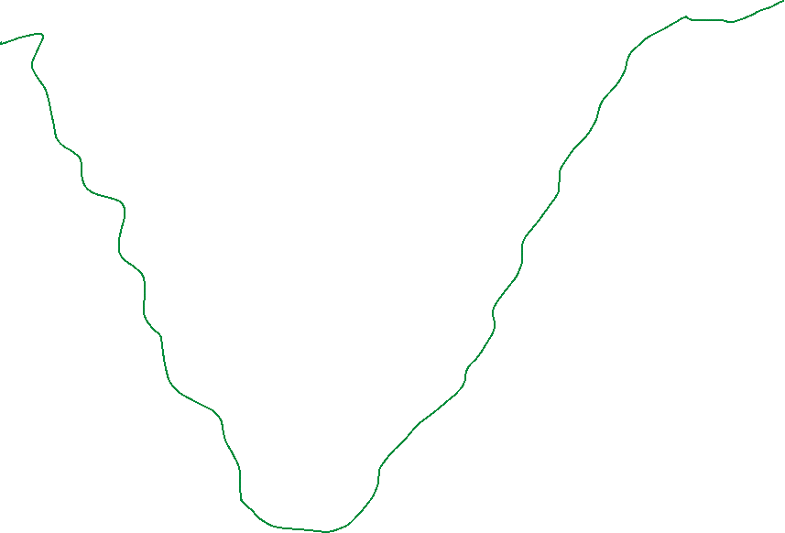
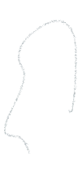



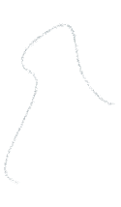


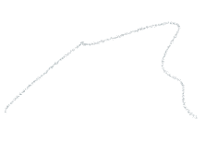
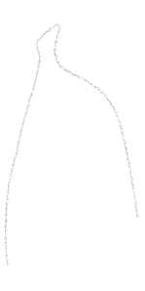

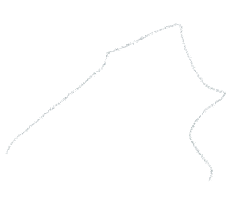


Slide 25


$∞$ CSPs
Fin. PCSPs
Inf.-dom. CSPs
Fin.-dom. PCSPs
Infinite-domain CSP tractability conjecture
Finite-domain PCSPs
Finite-domain CSP dichotomy theorem
Image created by Google Gemini

Slide 26
Infinite-domain CSP tractability conjecture
Finite-domain PCSPs
Finite-domain CSP dichotomy theorem

Slide 27



✓
x

Slide 28

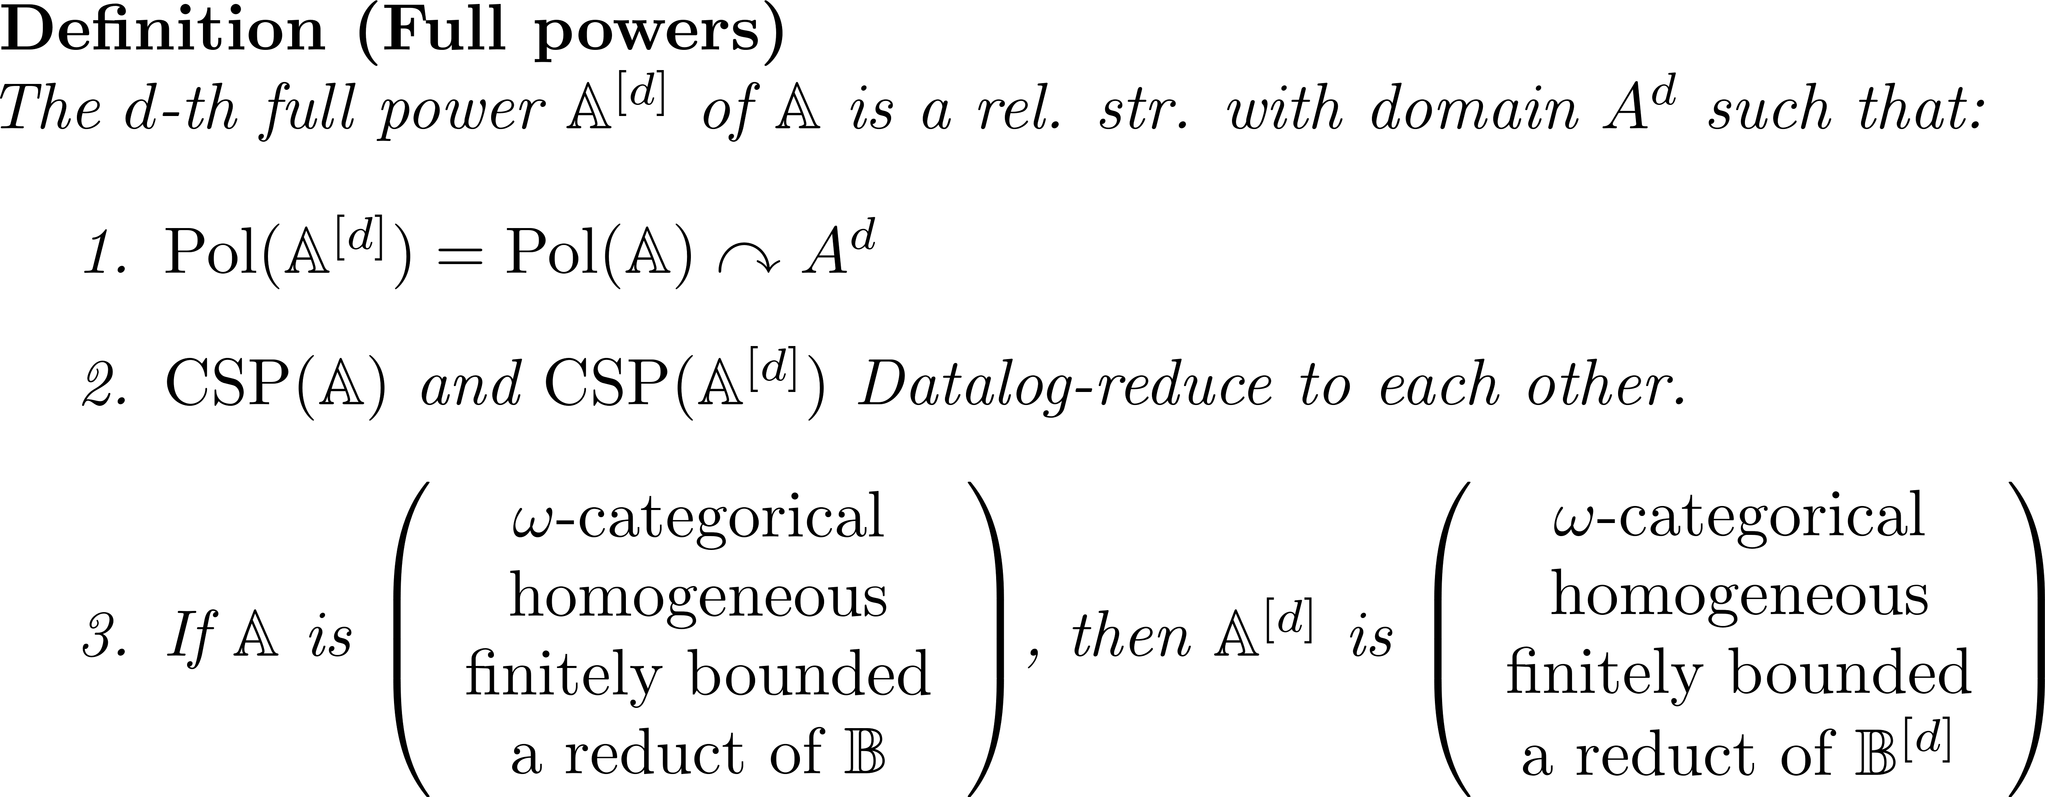
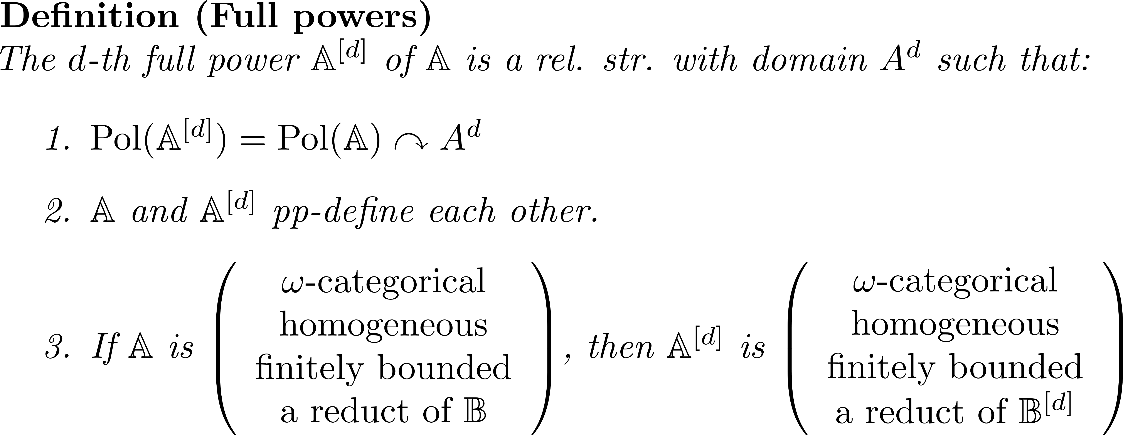

X

Slide 29

X

Slide 30




X

Slide 31


Slide 32



X
X
X

